Slide 1
The Bias-Variance Tradeoff
METIS

Slide 2
Learning Goals
Understand and correctly describe the bias-variance tradeoff, and its relationship with over/underfitting
Precisely identify and differentiate the 3 sources of predictive model error
Accurately describe model adjustments that impact complexity such as varying polynomial feature degrees

Slide 3
3 Sources of Model Error
Being wrong
Being unstable
Unavoidable randomness
Bias
Variance
Irreducible Error

Slide 4
3 Sources of Model Error in Detail
Bias
Variance
Irreducible Error
Tendency of predictions to miss true values
Worsened by missing information and simplifying assumptions about feature-target relationships
Miss real patterns (underfit)
Tendency of predictions to fluctuate
Worsened by model’s sensitivity to small changes in training data, often due to overly complex models
Overfit to noise patterns
Intrinsic uncertainty/randomness
Present in even the best possible model
Tendency = expectation of out-of-sample behavior over many training set samples

Slide 5
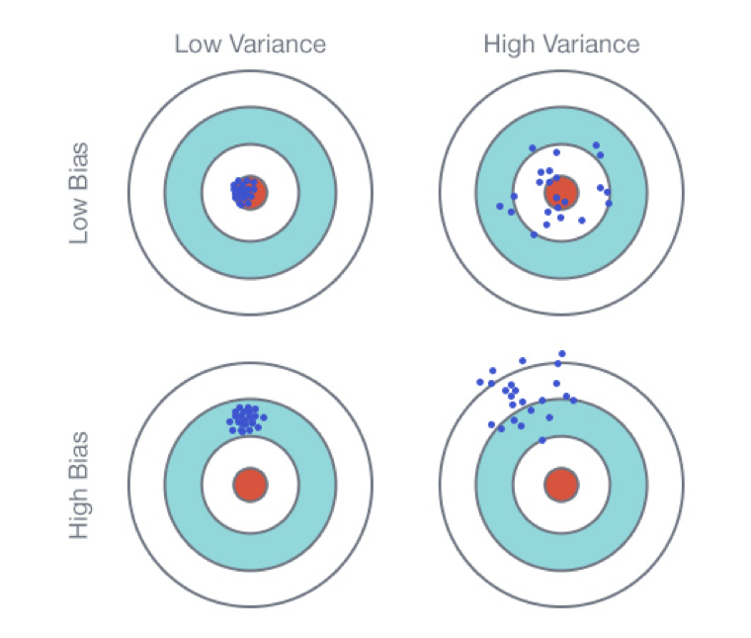
Bias & Variance Intuition
Bias & variance – at an intuitive level
Note: this visual is for intuition building and shouldn’t be interpreted literally!
Roughly, bias is tendency to miss, while variance is tendency to be inconsistent
Ideally we get the top left outcome: highly consistent predictions that are close to perfect on average

Slide 6
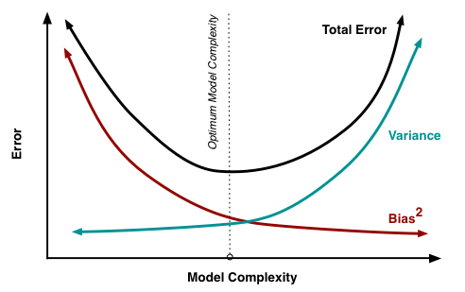
Bias-Variance Tradeoff, Visualized
Visualizing the complexity tradeoff
Usually we analogize the bias-variance tradeoff to a complexity tradeoff
Model adjustments that decrease bias often increase variance, and vice versa
Finding an optimally predictive model is essentially an exercise in finding the right balance of complexity
We search for a model that is elaborate enough to describe the feature-target relationship (not underfit), but not so elaborate that it fits to spurious patterns in the training data (not overfit)

Slide 7
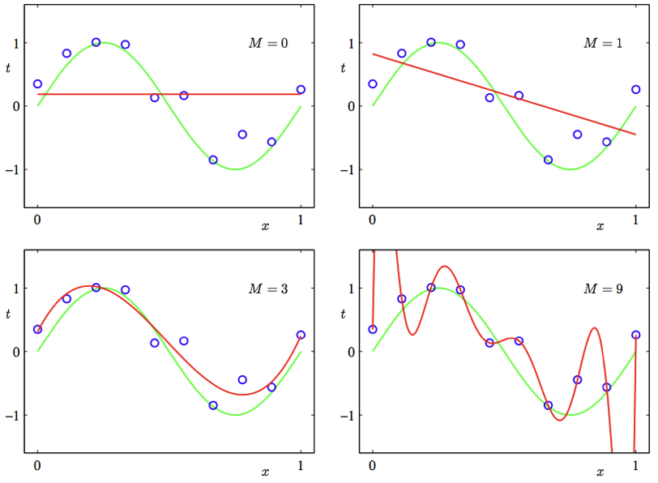
Bias-Variance Tradeoff: Example
Complexity tradeoff: polynomial regression
The higher the degree of a polynomial regression, the more complex the model (lower bias, higher variance)
At degrees 0 and 1, we can see visual signs of bias: the predictions are too rigid to capture the curve pattern in the data
At degree 9, we can see visual signs of variance: the predictions fluctuate wildly because of the model’s sensitivity
Degree 3 is just right: the model has sufficient complexity to describe the data without overfitting to noise

Slide 8
Lesson Recap
Optimizing predictive models is all about finding the right bias/variance i.e. complexity tradeoff
We need models that are sufficiently complex to capture patterns in data, but not so complex that they overfit to noise

Slide 9
Thank You!

Slide 10
Image Citations
Slides 6-7: Scott Fortmann-Roe
Slide 8: Justin Domke

